Slide 1

PBCST504 – MICROCONTROLLERS
MICRO PROJECT
Zeroth Review

Slide 2
JUICE JACKING USB USING ESP32
Title:- JUICE JACKING USB USING ESP32
Group No: 05
Members:
Anisha TJ: JEC24CC020
Anna Mariya Thomas: JEC24CC021
Joy Malayekal Abraham: JEC24CC040
S Arya Lakshmi: JEC24CC052
Savio Sajeev: JEC24CC053
Project Coordinator:
Ms.Sagna L T
Asst. Prof. CSE(CY)

Slide 3
JUICE JACKING USB USING ESP32
DEPARTMENT OF COMPUTER SCIENCE & ENGINEERING
(Cyber Security)
Vision of the Department
To be a globally recognized centre of excellence in Cyber Security education, research and innovation by nurturing ethical professionals , fostering technological advancement through responsible practice and contributing to a secure and sustainable digital society.

Slide 4
JUICE JACKING USB USING ESP32
DEPARTMENT OF COMPUTER SCIENCE & ENGINEERING
(Cyber Security)
Mission of the Department
M1: Excellence in Education : To provide outcome-based and industry-oriented education by integrating core computer science principles with advanced cybersecurity technologies and practices.
M2: Ethics and Professional Responsibility : To cultivate ethical values, integrity, social responsibility, and secure computing practices for protecting digital assets and strengthening cyber trust.
M3: Research, Innovation, and Entrepreneurship : To promote research, innovation, and entrepreneurial thinking for developing sustainable solutions to emerging cybersecurity challenges.
M4: Holistic and Global Development : To enhance leadership, teamwork, lifelong learning, and global competence through industry collaboration, interdisciplinary activities, and community engagement.

Slide 5
JUICE JACKING USB USING ESP32
Programme Educational Objectives (PEOs)
PEO 1: Graduates will apply strong foundations in computer science and cybersecurity to design, develop, and manage secure and reliable computing systems for industry and society.
PEO 2: Graduates will pursue successful careers as professionals, innovators or entrepreneurs engaged in technology development, deployment or engineering system implementation in industry and society and contribute to the economic growth of the country.
PEO 3: Graduates will demonstrate ethical responsibility, leadership, teamwork, and effective communication while adapting to evolving global technological environments through lifelong learning.

Slide 6
JUICE JACKING USB USING ESP32
Programme Outcomes
Engineering Graduates will be able to:
1. Engineering knowledge: Apply the knowledge of mathematics, science, engineering fundamentals, and an engineering specialization to the solution of complex engineering problems.
2. Problem analysis: Identify, formulate, review research literature, and analyze complex engineering problems reaching substantiated conclusions using first principles of mathematics, natural sciences, and engineering sciences.
3. Design/development of solutions: Design solutions for complex engineering problems and design system components or processes that meet the specified needs with appropriate consideration for the public health and safety, and the cultural, societal, and environmental considerations.
4. Conduct investigations of complex problems: Use research-based knowledge and research methods including design of experiments, analysis and interpretation of data, and synthesis of the information to provide valid conclusions.
5. Modern tool usage: Create, select, and apply appropriate techniques, resources, and modern engineering and IT tools including prediction and modeling to complex engineering activities with an understanding of the limitations.

Slide 7
JUICE JACKING USB USING ESP32
6. The engineer and society: Apply reasoning informed by the contextual knowledge to assess societal, health, safety, legal and cultural issues and the consequent responsibilities relevant to the professional engineering practice.
7. Environment and sustainability: Understand the impact of the professional engineering solutions in societal and environmental contexts, and demonstrate the knowledge of, and need for sustainable development.
8. Ethics: Apply ethical principles and commit to professional ethics and responsibilities and norms of the engineering practice.
9. Individual and team work: Function effectively as an individual, and as a member or leader in diverse teams, and in multidisciplinary settings.
10. Communication: Communicate effectively on complex engineering activities with the engineering community and with society at large, such as, being able to comprehend and write effective reports and design documentation, make effective presentations, and give and receive clear instructions.
11. Project management and finance: Demonstrate knowledge and understanding of the engineering and management principles and apply these to one’s own work, as a member and leader in a team, to manage projects and in multidisciplinary environments. 12. Life-long learning: Recognize the need for, and have the preparation and ability to engage in independent and life-long learning in the broadest context of technological change.

Slide 8
JUICE JACKING USB USING ESP32
Programme Specific Outcomes (PSOs)
On the completion of Computer Science & Engineering program, the students will possess:
PSO 1: Apply cyber security principles to mitigate cyber risk and analyze security requirements of an organization.
PSO 2: Develop and deploy secure software and infrastructure using modern tools and industry standards.
PSO 3: Uphold ethical, legal, and societal responsibilities while protecting privacy, data, and digital assets.

Slide 9
JUICE JACKING USB USING ESP32
CONTENTS
Motivation
Introduction
Problem Statement
Proposed Method
Basic Block Diagram
Conclusion
References

Slide 10
Motivation
JUICE JACKING USB USING ESP32
Public USB charging stations are becoming increasingly common.
Many people are unaware of the risk of Juice Jacking attacks.
Existing solutions are either inconvenient or expensive.
We wanted to develop a simple, portable, and affordable device that protects users while charging.
This project combines cybersecurity and embedded systems, making it practical and relevant to everyday life.

Slide 11
Introduction
JUICE JACKING USB USING ESP32
A portable cybersecurity device designed to protect smartphones during public USB charging
Built using an ESP32 microcontroller.
Blocks USB data lines by default, allowing only safe power charging.
Enables data transfer only when manually authorized by the user.
Displays the current operating mode on an OLED display.
Automatically switches back to safe charging mode after a preset timeout.
Uses low-cost, readily available components for easy implementation.

Slide 12
Problem Statement
JUICE JACKING USB USING ESP32
Public USB charging ports can steal data or install malware.
Users cannot tell if a charging port is safe.
Normal USB data blockers don't allow user control.
A smart, portable device is needed that:
- Blocks data by default.
- Allows data transfer only when needed.
- Automatically returns to safe charging mode.
- Is compact, affordable, and easy to use.

Slide 13
Proposed Method
JUICE JACKING USB USING ESP32
Connect the smartphone through the Smart USB Charge Protector.
The ESP32 blocks USB data by default and allows only charging.
Press the push button to enable data transfer when needed.
The OLED display shows the current operating mode.
After a preset time, the ESP32 automatically switches back to Safe Charging Mode.
This helps protect the smartphone from Juice Jacking attacks while charging.

Slide 14
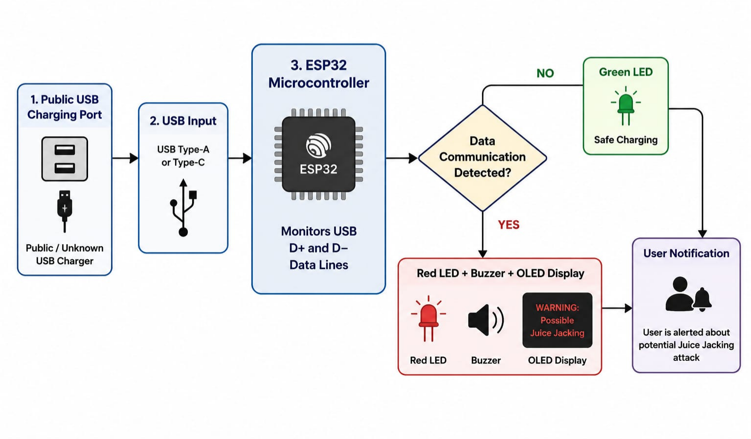
Basic Block Diagram
JUICE JACKING USB USING ESP32

Slide 15
Conclusion
JUICE JACKING USB USING ESP32
Protects smartphones from potential Juice Jacking attacks.
Ensures safe charging by blocking USB data communication by default.
Provides secure, user-controlled access to data transfer.
Compact, portable, cost-effective, and suitable for public charging environments.
Demonstrates the application of embedded systems in cybersecurity.

Slide 16
References
JUICE JACKING USB USING ESP32
USB Implementers Forum (USB Specifications)⁠
OWASP Mobile Application Security⁠
Federal Communications Commission (FCC) Consumer Guide: Juice Jacking⁠
National Security Agency (NSA) Cybersecurity Guidance⁠

